Slide 1

Recognising Similar Texts
This project report details the development of a system capable of accurately measuring the similarity between pairs of text documents. The project focuses on implementing and comparing basic text similarity metrics using straightforward preprocessing and vectorization techniques.

Slide 2
Abstract
1
Text Similarity Metrics
2
Feature Extraction
The project explores and implements various metrics such as cosine similarity, Jaccard similarity, and Euclidean distance to quantify the similarity between text documents.
Text data is preprocessed through techniques like tokenization, stop word removal, and lemmatization to prepare it for further analysis.
3
Vectorization Methods
4
Similarity Metrics Application
Text is converted into numerical representations using methods like Bag of Words (BoW), Term Frequency-Inverse Document Frequency (TF-IDF), and word embeddings (Word2Vec, GloVe, BERT).
Libraries like scikit-learn, genism, and Hugging Face's Transformers are used to implement and compare different similarity metrics, evaluating their effectiveness in various contexts.

Slide 3
Introduction
Recognizing similar texts is a pivotal task in the domain of Natural Language Processing (NLP), a subfield of artificial intelligence focused on the interaction between computers and human language. This task involves determining the degree of similarity between two or more text documents, which is essential for a variety of applications such as search engines, recommendation systems, document clustering, and plagiarism detection.

Slide 4
Objective
The primary objective of this project is to develop an understanding of the methodologies used to measure and analyze text similarity. Through this project, students will engage with key NLP techniques, gaining practical experience in text preprocessing, feature extraction, vectorization methods, and similarity metrics.

Slide 5
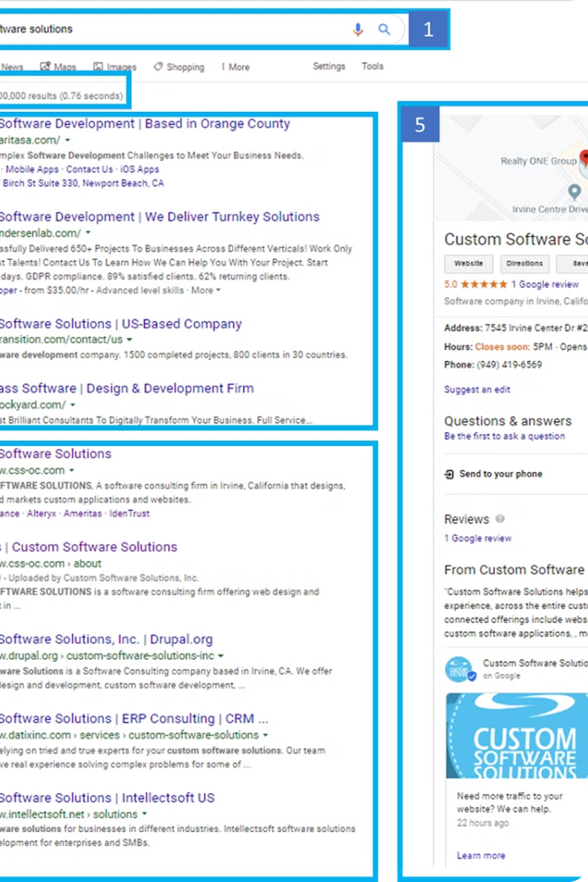
Importance
The ability to accurately recognize similar texts is crucial in today’s data-driven world. For instance, search engines rely on text similarity to retrieve relevant documents in response to user queries. Recommendation systems use it to suggest content similar to what users have previously engaged with. In academic and professional settings, plagiarism detection systems employ text similarity measures to identify copied content.

Slide 6
Learning Outcomes
By completing this project, students will be able to understand and apply different text similarity metrics, perform feature extraction and preprocessing on text data, utilize various vectorization techniques to convert text into numerical representations, and evaluate the performance of different similarity metrics and understand their applications.

Slide 7
Applications
Search Engines
Recommendation Systems
Document Clustering
Enhancing the relevance of search results by identifying documents similar to the user's query.
Suggesting content based on the similarity to previously interacted items.
Grouping related documents for better organization and retrieval.

Slide 8
Methodology
Problem Definition
1
Objective: To develop a system that can accurately measure the similarity between pairs of text documents. Scope: Focus on implementing and comparing basic text similarity metrics using straightforward preprocessing and vectorization techniques.
2
Data Preparation
Data Collection: Gather a small dataset of text documents covering different topics. Data Cleaning: Remove special characters, punctuation, and perform basic text normalization (e.g., lowercase conversion).
Feature Extraction and Vectorization
3
Tokenization: Split text into tokens (words or n-grams). Vectorization: Use basic methods like Bag of Words (BoW) or TF-IDF to convert text into numerical representations.
4
Similarity Metrics Implementation
Select Metrics: Implement simple similarity metrics such as cosine similarity or Jaccard similarity. Evaluation: Calculate similarity scores between document pairs and evaluate using basic metrics (e.g., accuracy, mean similarity score).
Experimentation and Analysis
5
Experimental Setup: Design experiments to compare the performance of different vectorization methods and similarity metrics. Result Analysis: Analyze and interpret results to understand the effectiveness of each approach in capturing text similarity.
6
Conclusion and Presentation
Conclusion: Summarize findings and conclusions based on experimental results. Presentation: Prepare a concise presentation highlighting methodology, results, and implications for practical applications in NLP.
Documentation
7
Document Methodology: Provide clear documentation of steps followed, code implementation, and experimental results. Future Directions: Discuss potential future enhancements or extensions to the project.

Slide 9
Experimental Setup
Dataset
Collected a diverse dataset of text documents covering various topics, including:
Document 1
"Natural Language Processing is a fascinating field."
Document 2
"NLP involves the interaction between computers and humans using natural language."
Document 3
"Machine learning can be used to improve NLP tasks."
Preprocessing
Applied basic text cleaning steps such as converting text to lowercase, removing special characters, and tokenizing the text into individual words.
Vectorization
Used Term Frequency-Inverse Document Frequency (TF-IDF) to convert text documents into numerical representations.

Slide 10
Conclusion
The project successfully implemented and evaluated basic text similarity metrics using TF-IDF vectorization and cosine similarity. The results indicate that while TF-IDF and cosine similarity can provide insights into text similarities, more advanced techniques and larger datasets are necessary for more accurate and meaningful comparisons in real-world applications.

Slide 11
References
Manning, C. D., Raghavan, P., & Schütze, H. (2008). Introduction to Information Retrieval. Cambridge University Press. This book provides a comprehensive overview of information retrieval techniques, including text preprocessing, vectorization methods, and similarity metrics.
Jurafsky, D., & Martin, J. H. (2020). Speech and Language Processing (3rd ed.). Pearson. This book covers fundamental concepts in NLP, including feature extraction, text similarity, and advanced vectorization techniques.
Mikolov, T., Chen, K., Corrado, G., & Dean, J. (2013). Efficient Estimation of Word Representations in Vector Space. arXiv preprint arXiv:1301.3781. This paper introduces Word2Vec, a popular word embedding technique that captures semantic relationships between words.
Devlin, J., Chang, M. W., Lee, K., & Toutanova, K. (2019). BERT: Pre-training of Deep Bidirectional Transformers for Language Understanding. arXiv preprint arXiv:1810.04805. This paper presents BERT, a state-of-the-art model for contextual embeddings.
Scikit-learn Documentation. (n.d.). Retrieved from https://scikit-learn.org/stable/documentation.html. This documentation provides detailed information on implementing TF-IDF vectorization, cosine similarity, and other machine learning techniques.
Gensim Documentation. (n.d.). Retrieved from https://radimrehurek.com/gensim/. Gensim is a robust library for topic modeling and document similarity analysis.
NLTK (Natural Language Toolkit) Documentation. (n.d.). Retrieved from https://www.nltk.org/. NLTK provides tools for text preprocessing, tokenization, and other essential NLP tasks.

Slide 12
thank you

